Slide 1
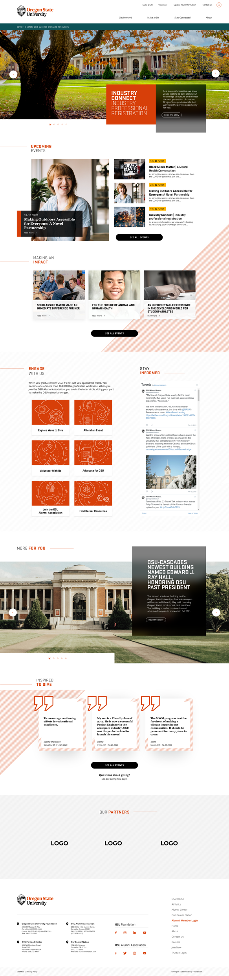
Oregon State University Foundation and Alumni

Slide 2



Oregon State University Foundation and Alumni
Problem
Process
Outcome
Multiple sites, each with their own hosting environment and support needs
Disjointed brand across different properties
Disjointed design and mixed visuals
Poor SEO rankings
Users failing to complete objectives
Limited reasons for return visitors
Development of new, unified Digital Brand.
SEO technical audit and plan alignment
Information architecture research, workshops, and iterations
Developed personas to align and represent user base
Designed wireframes, web brand guide, and high-fidelity comps
Launch of consolidated site
Increased engagement for return users
Stabilized SEO
Digital brand established and ready for expansion

Slide 3
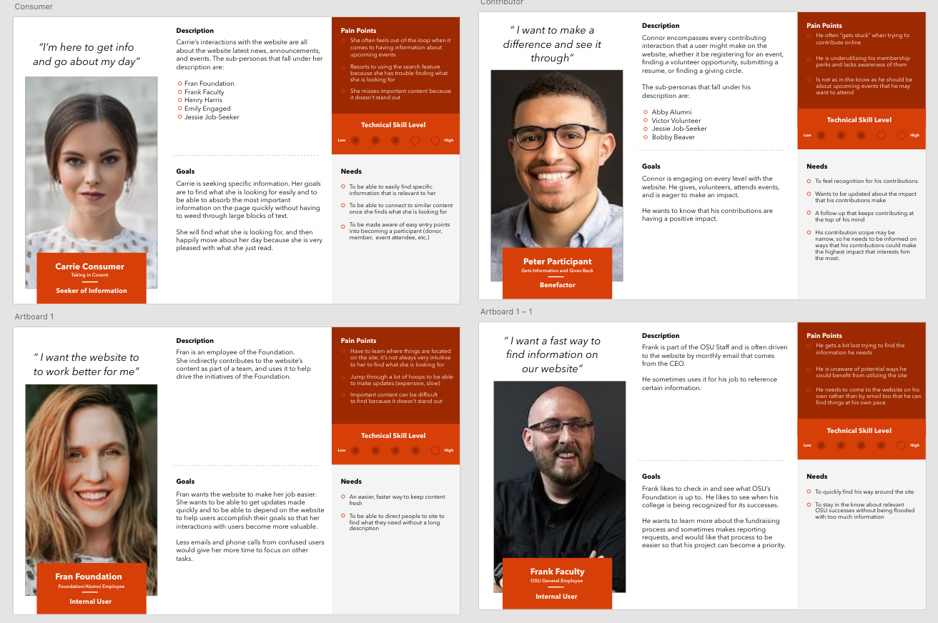
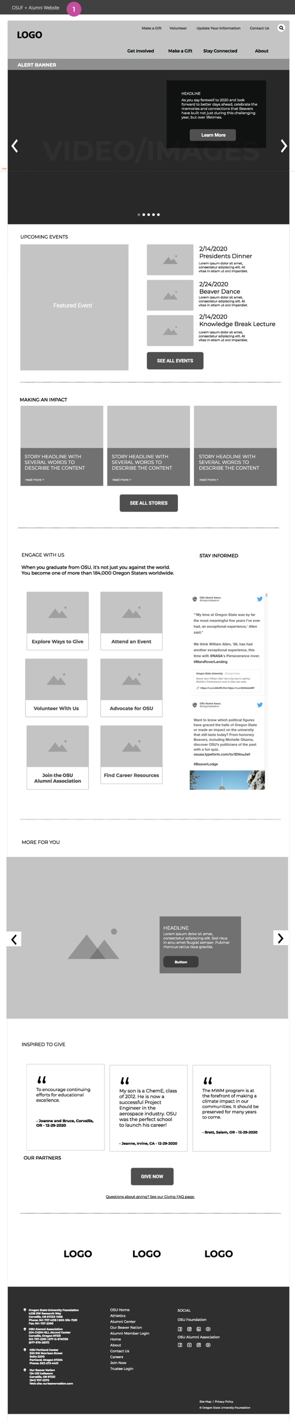
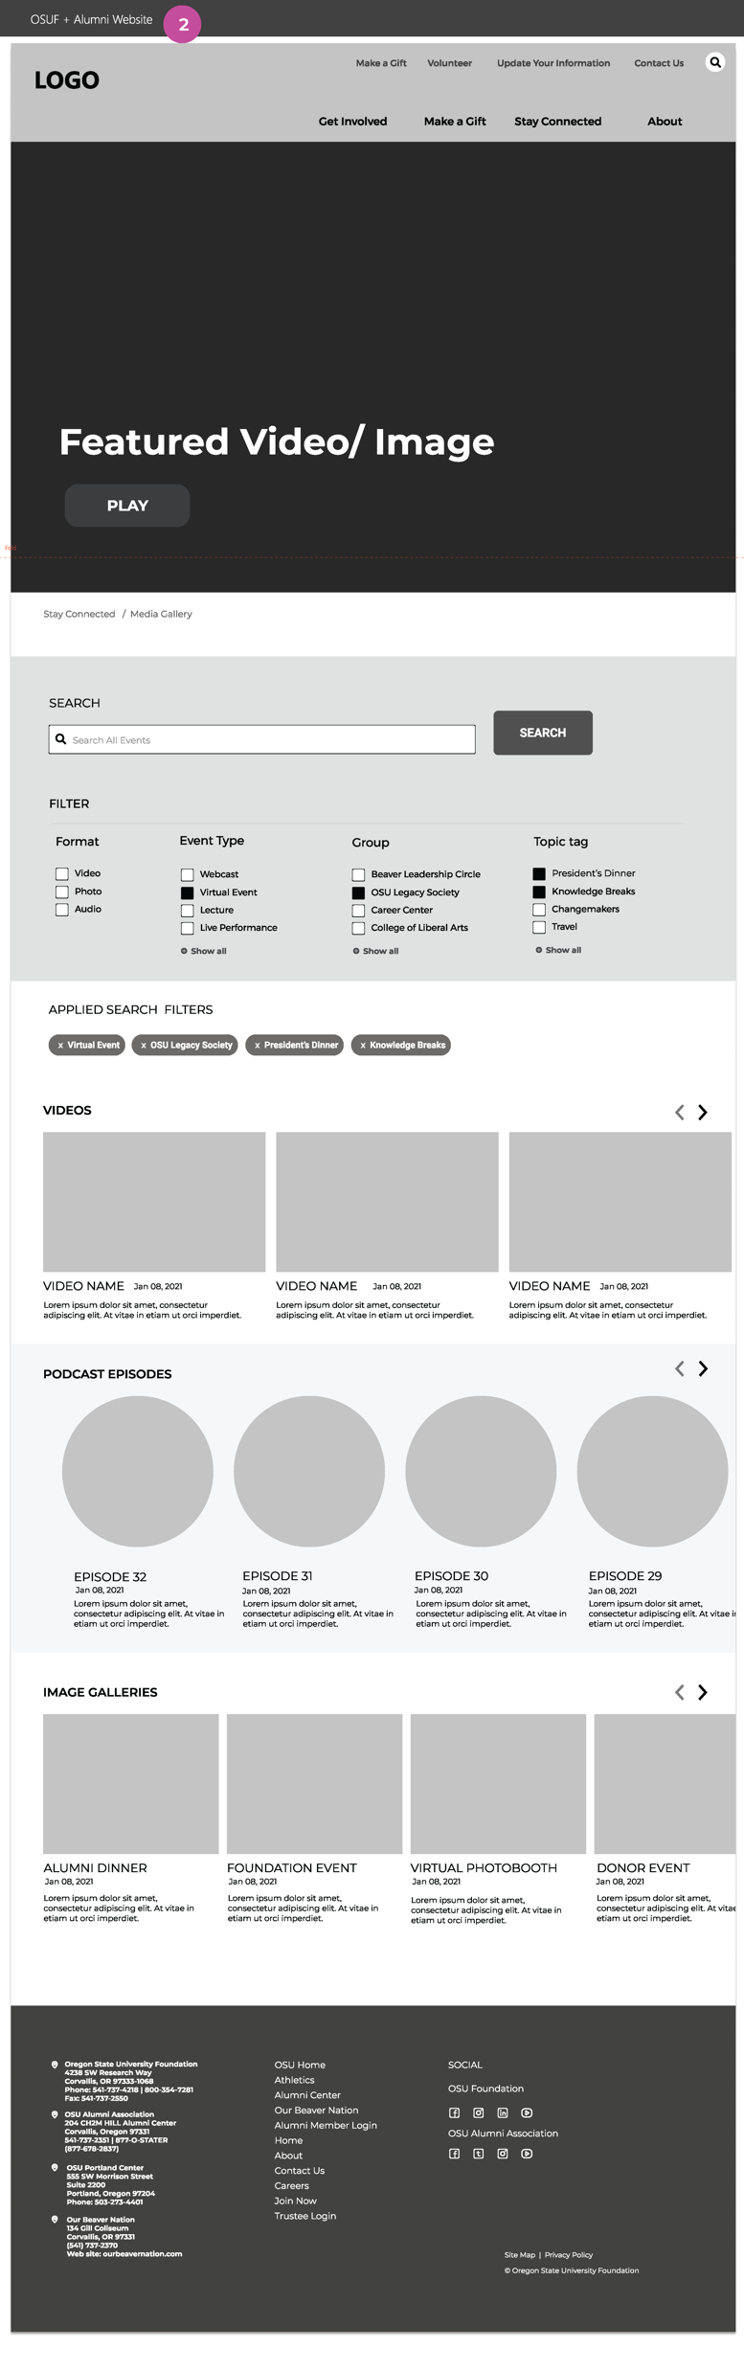
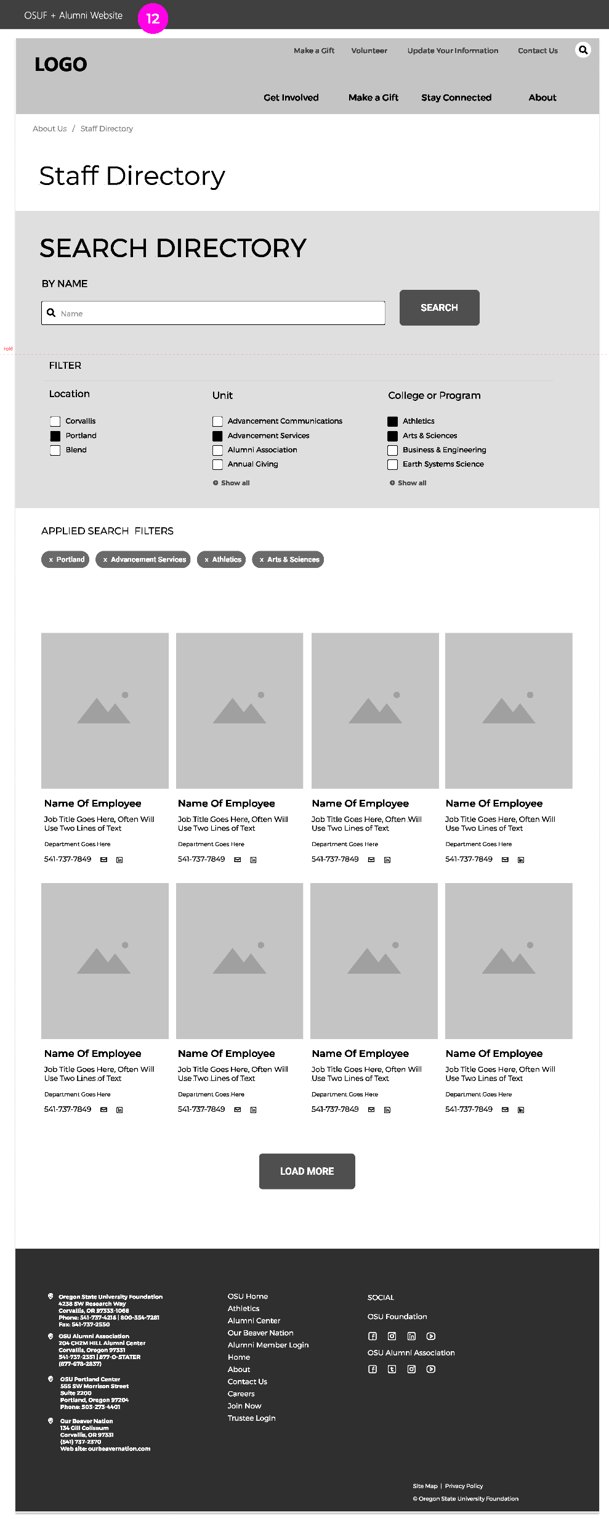
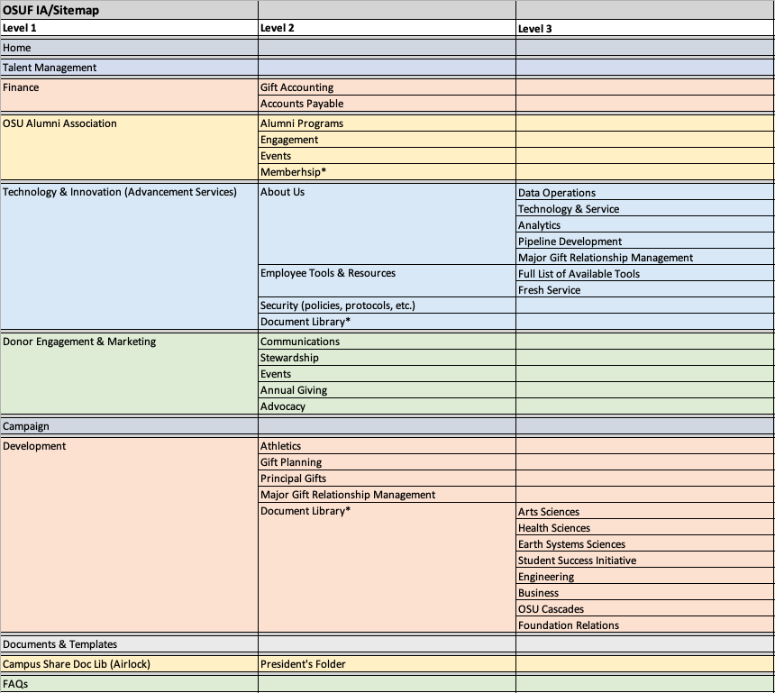
Oregon State University Foundation and Alumni

Slide 4
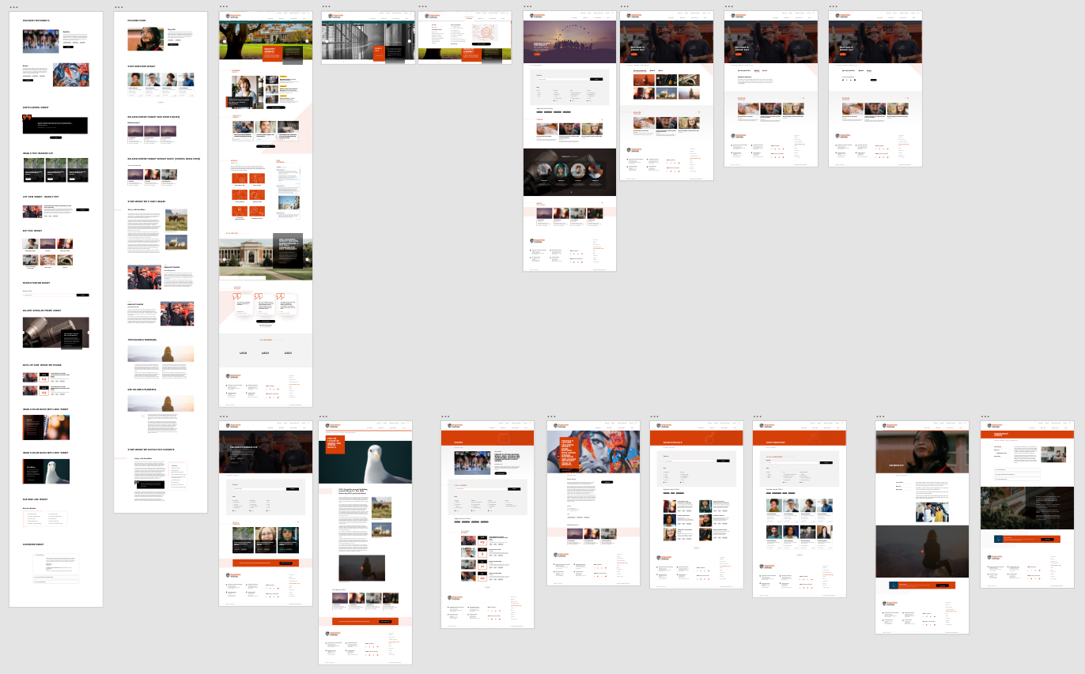
Oregon State University Foundation and Alumni

Slide 5
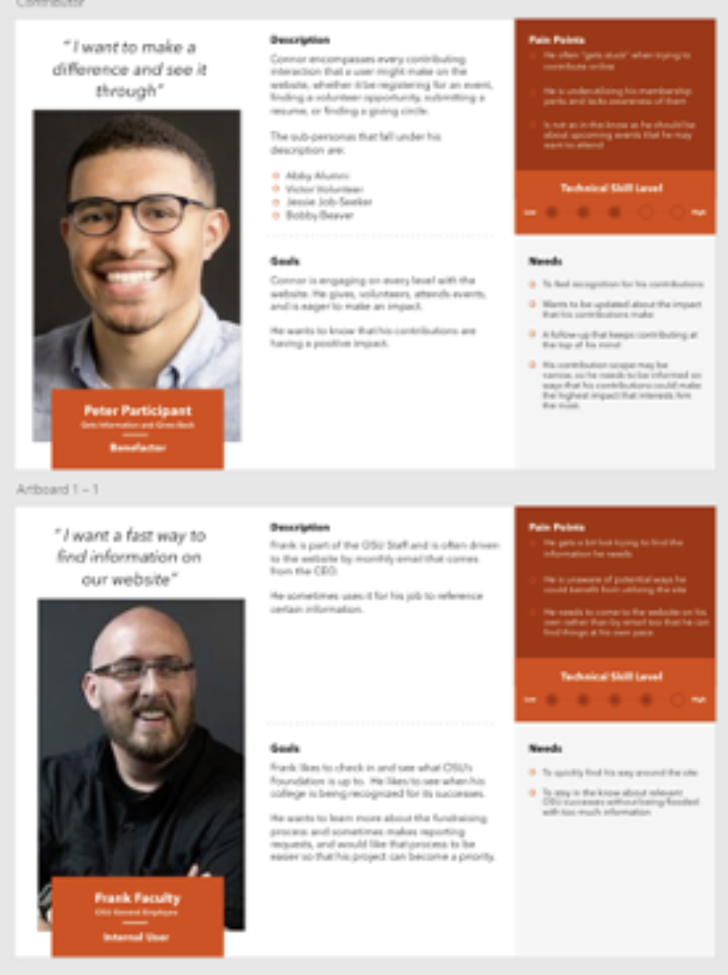
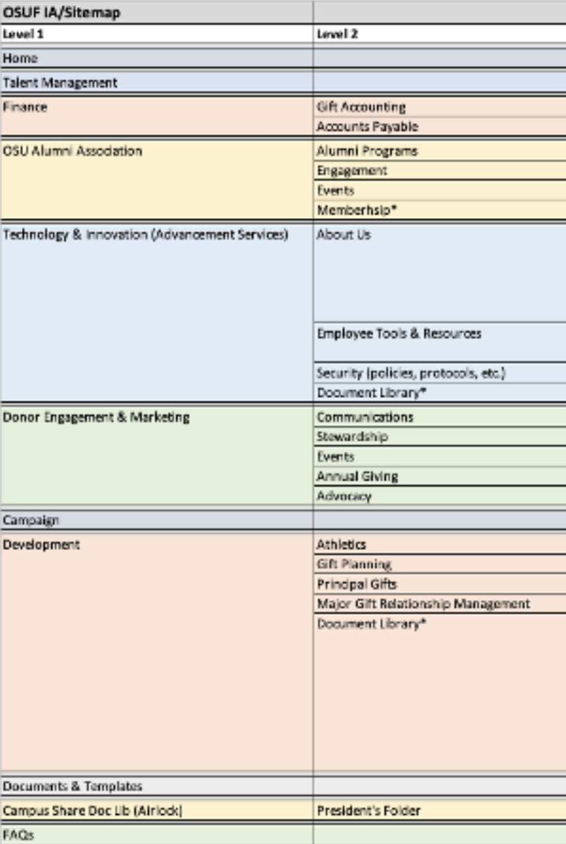
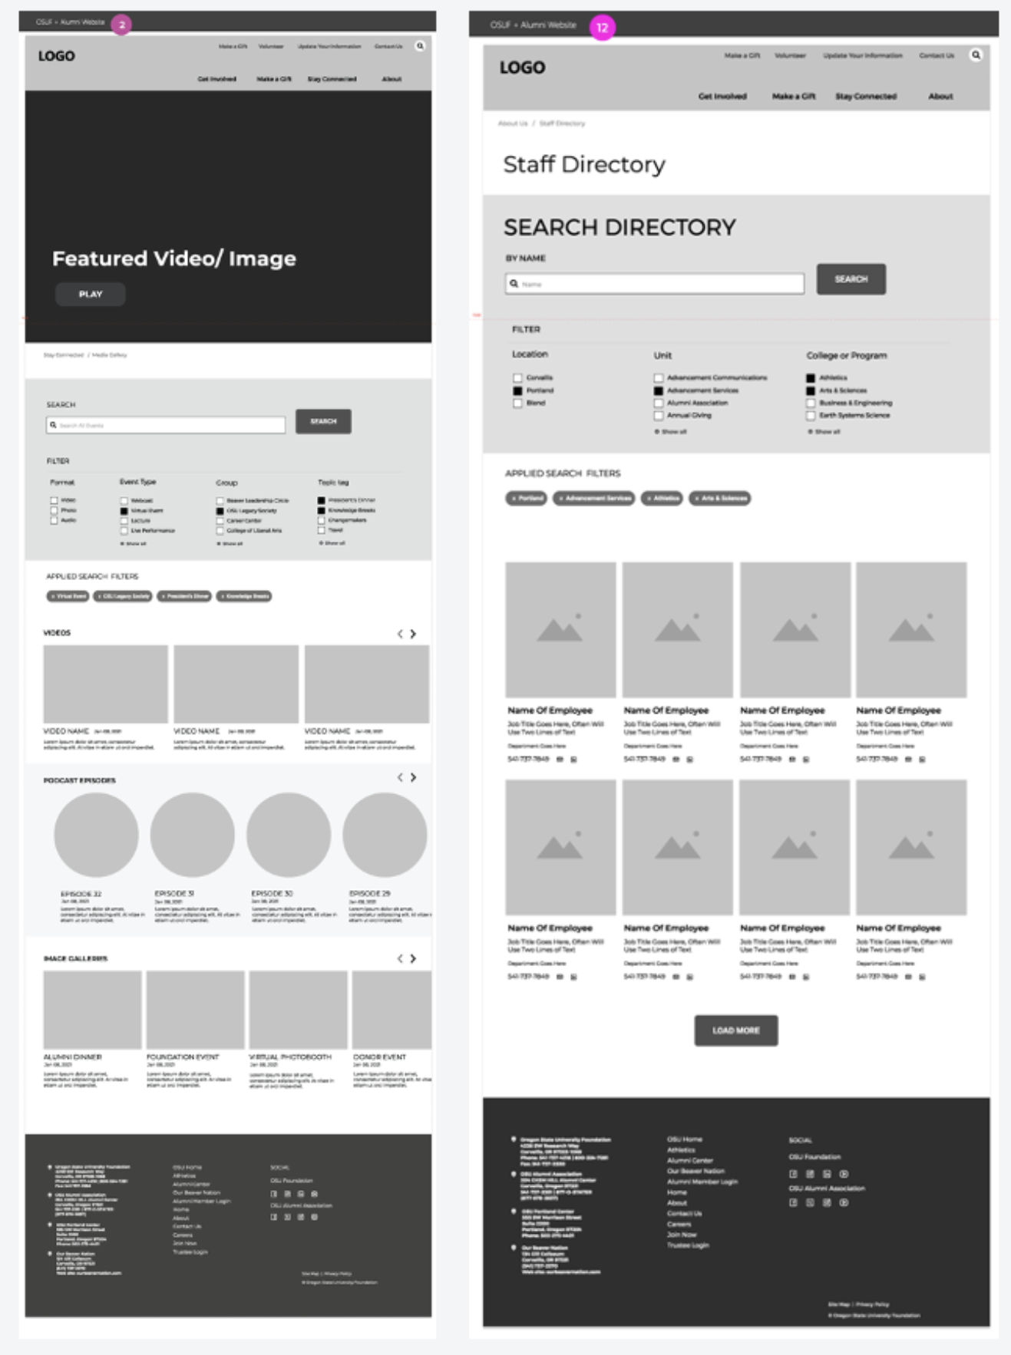
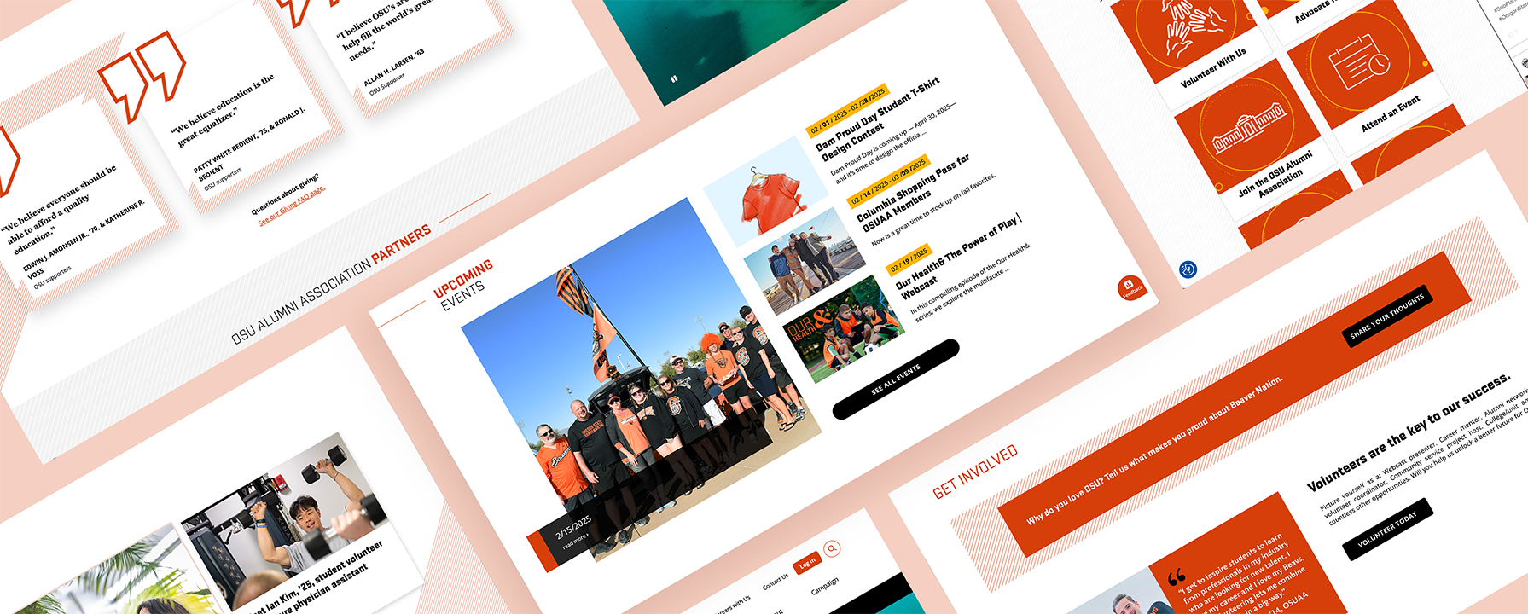
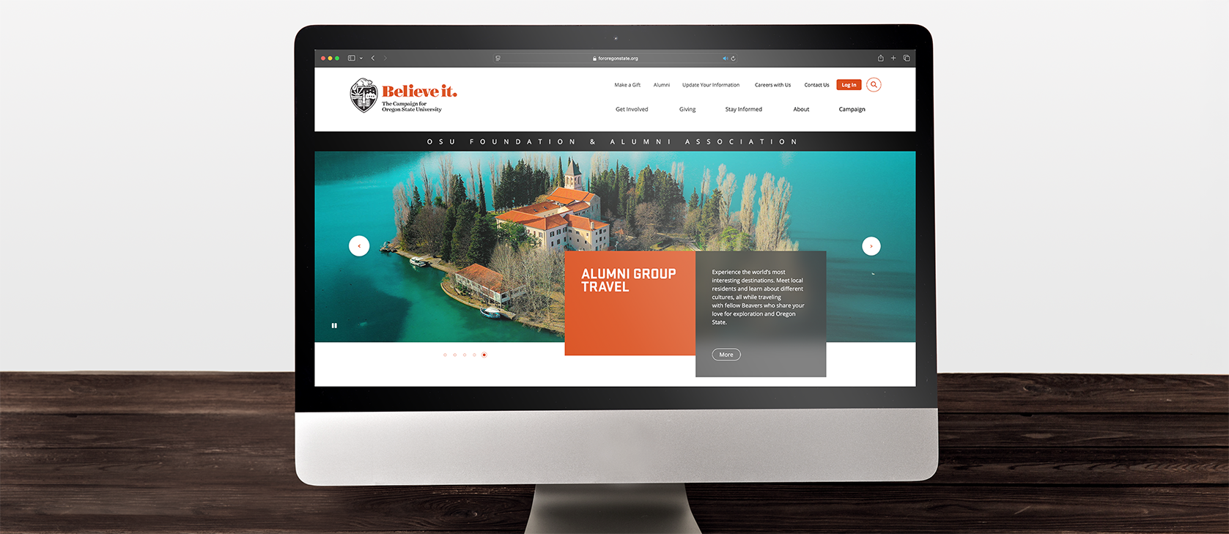
Oregon State University Alumni Foundation
UI/UX Design
OSU had multiple disjointed websites with varying hosts and support, leading to a clunky user experience. Affirma was tasked with creating a unified website to address these issues. Through design and marketing research, we launched a streamlined site with a consistent and accessible look/feel with room for growth. SEO was improved, and returning user engagement increased. We provided guidance to support the University moving forward.
Project Team:
6 People
Project Duration:
3 Months
Services:
User Interface Design
User Experience Improvement
Search Engine Optimization (SEO)
Large Systems Design
Wireframing & Prototyping
Web Style Guide
Marketing Personas
Accessibility

